Slide 1

18CSC203J - COA PARALLELISM
SRM
INSTITUTE OF SCIENCE AND TECHNOLOGY

Slide 2
Course Learning Rationale (CLR)
CLR-4 : Study about parallel processing and performance considerations.

Slide 3
Course Learning Outcome (CLO)
CLO-4 : Analyze concepts of parallelism and multi-core processors

Slide 4
Contents
Parallelism
Need for parallelism
Types of Parallelism
Applications of Parallelism
Parallelism in Software
Instruction level parallelism
Data level parallelism
Challenges in Parallelism
Architecture of Parallel system
Flynn’s Classification
SISD , SIMD
MIMD, MIMD
Hardware Multi threading
Coarse grain Parallelism
Fine grain Parallelism
Uni-Processor and Multi Processor
Muti-core Processor
Memory in multi-processor system
Cache Coherency in multi-processor system
MESI Protocol for multi-processor system

Slide 5
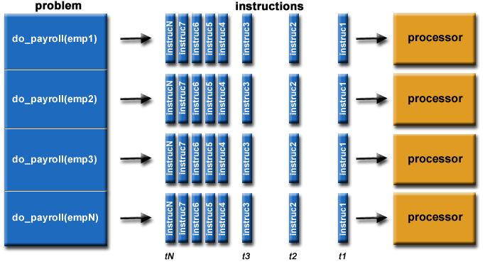
Parallelism
Executing two or more operations at the same time is known as parallelism.
Image Courtesy : https://computing.llnl.gov/tutorials/parallel_comp/

Slide 6
Parallel Processing
Parallel processing improves the performance by executing two or more instructions simultaneously
A parallel computer is a set of processors that are able to work cooperatively to solve a computational problem.
On a single processor may have Two or more ALUs which work concurrently to increase throughput
The system may have two or more processors operating concurrently (Eg: i3,i5,i7)

Slide 7
Goals of parallelism:
To increase the computational speed (ie) to reduce the amount of time that you need to wait for a problem to be solved
To increase throughput (ie) the number of processes completed on unit time
To improve the performance of the computer for a given clock speed
To solve bigger problems that might not fit in the limited memory of a single CPU
To take advantage of non-local resources when the local resources are finite

Slide 8
Applications of Parallelism
Numeric weather prediction
Socio economics
Finite element analysis
Artificial intelligence and automation
Genetic engineering
Weapon research and defense
Medical Applications
Remote sensing applications

Slide 9
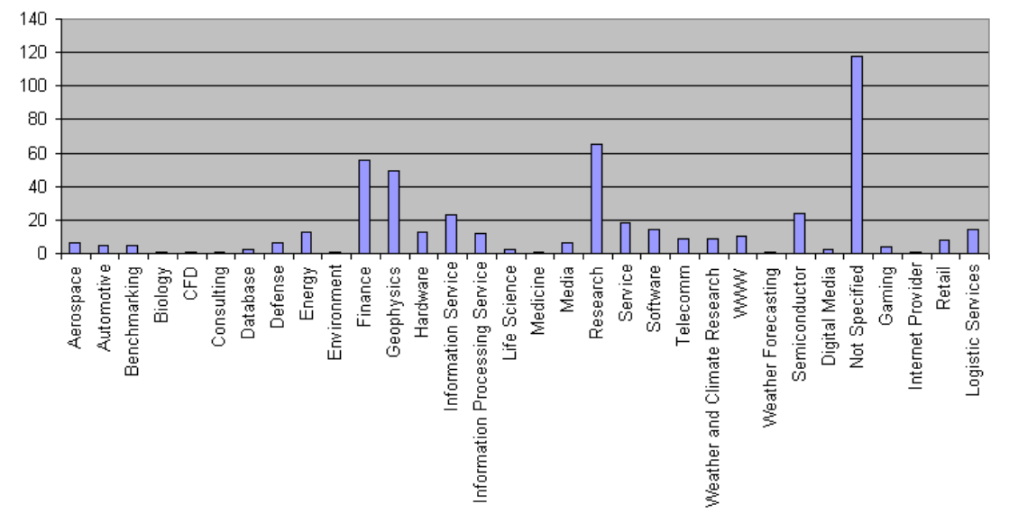
Applications of Parallelism

Slide 10
Types of parallelism
Hardware Parallelism
2. Software Parallelism
Hardware Parallelism :
It is based on the processor multiplicity and machine architecture.
One way to characterize the parallelism in a processor is by the number of instruction issues per machine cycle. If a processor sends k instructions per machine cycle, then it is called a k-issue processor

Slide 11
Software Parallelism
Determined by the dependency among the sub tasks
The flow control graph used to represent the degree of parallelism in the program
The flow graphs shows the possible ways in which the sub programs can be executed in parallel.
Software parallelism can be exhibited by the algorithm, programming pattern (threads) and optimization on compilers
Parallelism in a program varies during the execution period .
It limits the sustained performance of the processor.

Slide 12
Example
Example:
A=L1 * L2 + L3 * L4
B=L1 * L2 - L3 * L4
Software Parallelism:
There are 8 instructions
FOUR Load instructions(L1,L2,L3&L4).
TWO Multiply instructions(X1&X2)
ONE Add instruction(+)
ONE Subtract instruction(-)
The parallelism varies from 4 to 2 in three cycles.

Slide 13
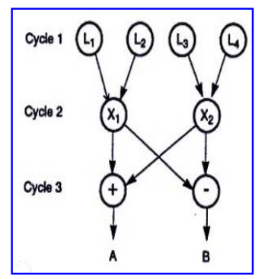


Slide 14
Hardware Parallelism - example
Parallel Execution:
Using TWO-issue processor:
The processor can execute one memory access(Load / Store) and one arithmetic operation(multiply/add/subtract) simultaneously.
The program must execute in 7 cycles.
The h/w parallelism average is 8/7=1.14.
It is clear from this example that there is a mismatch between the s/w and h/w parallelism.

Slide 15
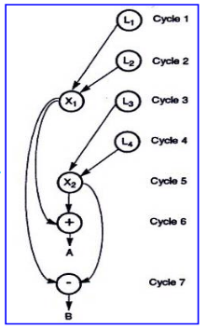

Slide 16
Software Parallelism - types
Instruction level parallelism
Task-level parallelism
Data parallelism
Transaction level parallelism

Slide 17
Instruction level parallelism
Instruction level Parallelism (ILP) is a measure of how many operations (instructions) can be performed in parallel at the same time in a computer program.
Parallel instructions are set of instructions that do not depend on each other for execution
ILP allows the compiler and processor to overlap the execution of multiple instructions or even to change the order in which instructions are executed.

Slide 18
Eg. Instruction level parallelism
Consider the following example
1. x= a+b
2. y=c-d
3. z=x * y
Operation depends on the results of 1 & 2
So ‘Z ‘ cannot be calculated until X & Y are calculated
But 1 & 2 do not depend on any other. So they can be computed simultaneously.

Slide 19



















Slide 20
If we assume that each operation can be completed in one unit of time then theses 3 operations can be completed in 2 units of time .
ILP factor is 3/2=1.5 which is greater than without ILP.
A superscalar CPU architecture implements ILP inside a single processor which allows faster CPU throughput at the same clock rate.

Slide 21
Data-level parallelism (DLP)
Data parallelism is parallelization across multiple processors in parallel computing environments.
It focuses on distributing the data across different nodes, which operate on the data in parallel.
Instructions from a single stream operate concurrently on several data
Limited by non-regular data manipulation patterns and by memory bandwidth

Slide 22
DLP - example
Let us assume we want to sum all the elements of the given array of size n and the time for a single addition operation is Ta time units.
In the case of sequential execution, the time taken by the process will be n*Ta time unit
if we execute this job as a data parallel job on 4 processors the time taken would reduce to (n/4)*Ta + merging overhead time units.

Slide 23
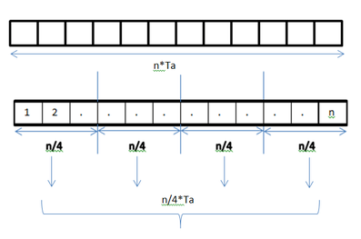
DLP in Adding elements of array

Slide 24
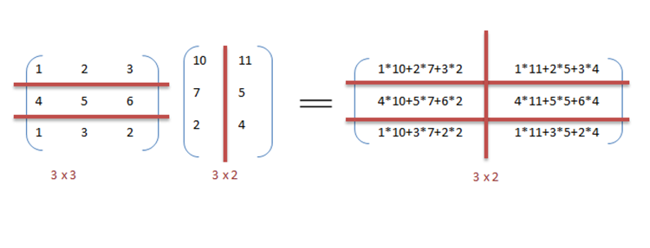
DLP in matrix multiplication
A[m x n] dot B [n x k] can be finished in O(n) instead of O(m∗n∗k ) when executed in parallel using m*k processors.

Slide 25
The locality of data references plays an important part in evaluating the performance of a data parallel programming model.
Locality of data depends on the memory accesses performed by the program as well as the size of the cache.

Slide 26
Instruction-level parallelism (ILP)
Executes the multiple instructions on same instruction streams simultaneously.
These ae generated and managed by either hardware (superscalar) or by compiler (VLIW) – Limited in practice by data and control dependences

Slide 27
Thread-level or task-level parallelism (TLP)
Multiple program/Task threads are created for same application and executed simultaneously
These task threads are created and managed by compiler and hardware, however the program threads are created by programmer and managed by compiler and hardware during run time.
User rarely since suffers by communication/ synchronization overheads

Slide 28
Challenges under parallel processing
The Hardware Model
Limitations on the Window Size and Maximum Issue Count
The Effects of Realistic Branch and Jump Prediction
The Effects of Finite Registers
The Effects of Imperfect Alias Analysis
Courtesy ; https://facultytalkies.com/courses/cs8491-computer-architecture-online-video-course/lessons/parallel-processing/

Slide 29
Flynn’s Classification
Was proposed by researcher Michael J. Flynn in 1966.
It is the most commonly accepted taxonomy of computer organization.
In this classification, computers are classified by whether it processes a single instruction at a time or multiple instructions simultaneously, and whether it operates on one or multiple data sets.

Slide 30
Flynn’s Classification
This taxonomy distinguishes multi-processor computer architectures according two independent dimensions
Instruction stream
Data stream.
An instruction stream is sequence of instructions executed by machine.
A data stream is a sequence of data including input, partial or temporary results used by instruction stream.
Each of these dimensions can have only one of two possible states: Single or Multiple.
Flynn’s classification depends on the distinction between the performance of control unit and the data processing unit rather than its operational and structural interconnections.

Slide 31
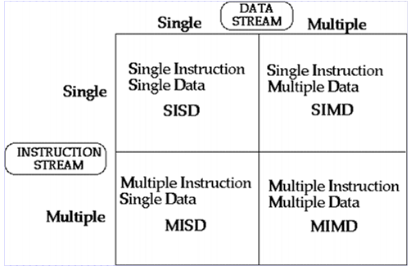
Flynn’s Classification
Four category of Flynn classification

Slide 32
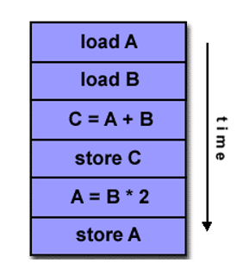

SISD
They are also called scalar processor i.e., one instruction at a time and each instruction have only one set of operands.
Single instruction: only one instruction stream is being acted on by the CPU during any one clock cycle.
Single data: only one data stream is being used as input during any one clock cycle.
Deterministic execution.
Instructions are executed sequentially.
SISD computer having one control unit, one processor unit and single memory unit.

Slide 33
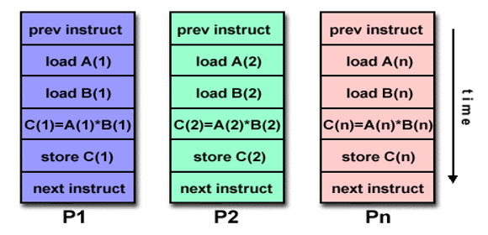
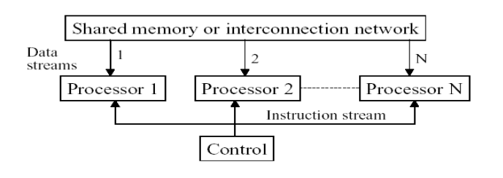
SIMD
A type of parallel computer.
Single instruction: All processing units execute the same instruction issued by the control unit at any given clock cycle .
Multiple data: Each processing unit can operate on a different data element as shown if figure below the processor are connected to shared memory or interconnection network providing multiple data to processing unit
single instruction is executed by different processing unit on different set of data

Slide 34
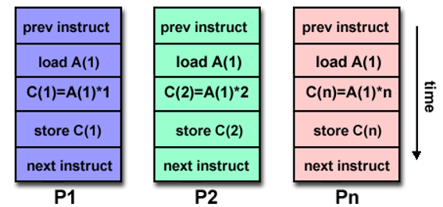
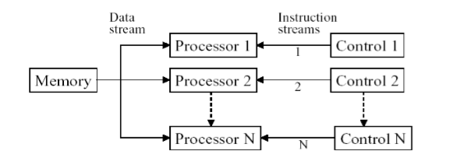
MISD
same data flow through a linear array of processors executing different instruction streams
A single data stream is fed into multiple processing units.
Each processing unit operates on the data independently via independent instruction.
A single data stream is forwarded to different processing unit which are connected to different control unit and execute instruction given to it by control unit to which it is attached.

Slide 35
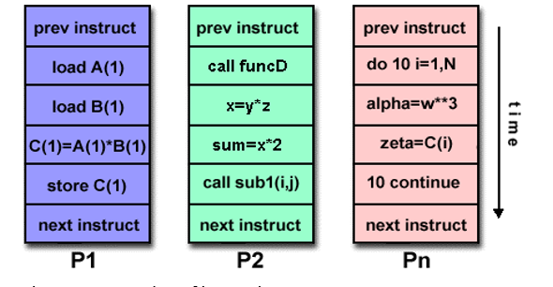
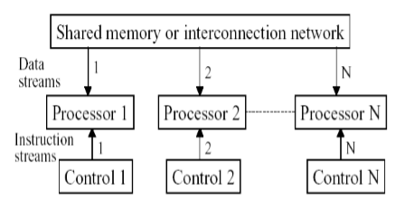
MIMD
Different processor each processing different task.
Multiple Instruction: every processor may be executing a different instruction stream.
Multiple Data: every processor may be working with a different data stream.
Execution can be synchronous or asynchronous, deterministic or nondeterministic

Slide 36
Thread and Multithreads
It is an instruction stream with state (Register/Memory)
The Thread state is called as thread context (Register state → Register context)
It may belongs to same process or different processes
Threads in the same program share the same address space
Under Multi threading/ Multitasking→ when new tread need execution, processor saves the older thread context and takes up the new thread context.

Slide 37
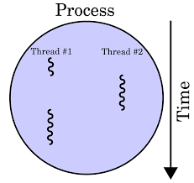
Hardware Multithreading
Hardware multithreading allows multiple threads to share the functional units of a single processor in an overlapping fashion to try to utilize the hardware resources efficiently.
To permit this sharing, the processor must duplicate the independent state of each thread. It Increases the utilization of a processor
For example, each thread would have a separate copy of register file and program counter. The memory itself can be shared through virtual memory mechanisms, which already support multi-programming.
In addition, hardware must supportability to change to a different thread relatively quickly. In particular, a thread switch should be much more efficient than a process switch, which typically requires hundreds to thousands of processor cycles while a thread switch can be instantaneous.
Courtesy: Wikipedia

Slide 38
Multithreading Types
Fine Grained
Course Grained
Simultaneous

Slide 39
Fine grained multi threading
Fine-grained multithreading switches between threads on each instruction, resulting in interleaved execution of multiple threads.
This interleaving is often done in around-robin fashion, skipping any threads that are stalled at that clock cycle.
To make fine-grained multithreading practical, processor must be able to switch threads on every clock cycle.
One advantage of fine-grained multithreading is that it can hide throughput losses that arise from both short and long stalls, since instructions from or threads can be executed when one thread stalls.
The primary disadvantage of fine-grained multithreading is that it slows down execution of individual threads, since a thread that is ready to execute without stalls will be delayed by instructions from or threads.

Slide 40
Coarse grained multi threading
Coarse-grained multithreading was invented as an alternative to fine-grained multithreading.
Coarse-grained multithreading switches threads only on costly stalls, such as last-level cache misses.
This change relieves need to have thread switching be extremely fast and is much less likely to slow down execution of an individual thread, since instructions from or threads will only be issued when a thread encounters a costly stall.
Drawback: it is limited in its ability to overcome throughput losses, especially from shorter stalls.
This limitation arises from pipeline start-up costs of coarse-grained multithreading. Because a processor with coarse-grained multithreading issues instructions from a single thread, when a stall occurs, pipeline must be emptied or frozen.
The new thread that begins executing after stall must fill pipeline before instructions will be able to complete. Due to start-up overhead, coarse-grained multithreading is much more useful for reducing penalty of high-cost stalls, where pipeline refill is negligible compared to stall time.

Slide 41
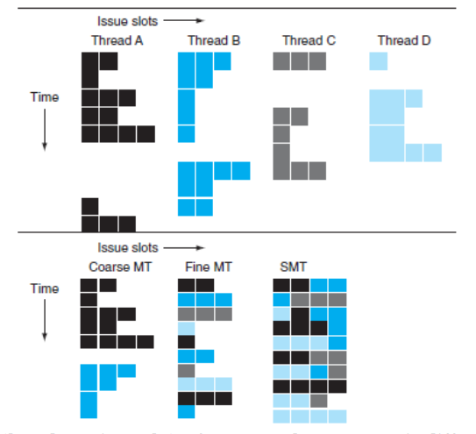
Comparison

Slide 42
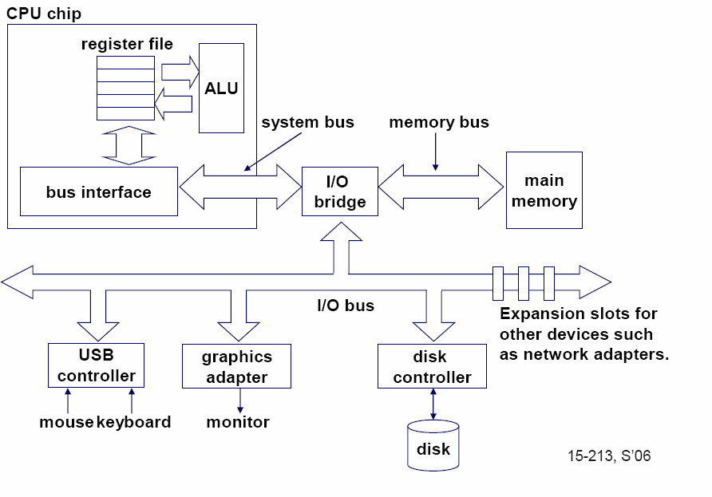
Single-core computer
42

Slide 43
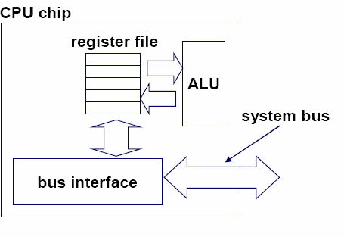
Single-core CPU chip
the single core
43

Slide 44
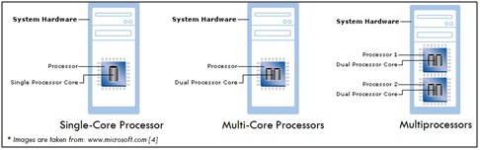
Single Vs Multicore Processors
Courtesy: https://facultytalkies.com/courses/cs8491-computer-architecture-online-video-course/lessons/multi-core-processors/

Slide 45
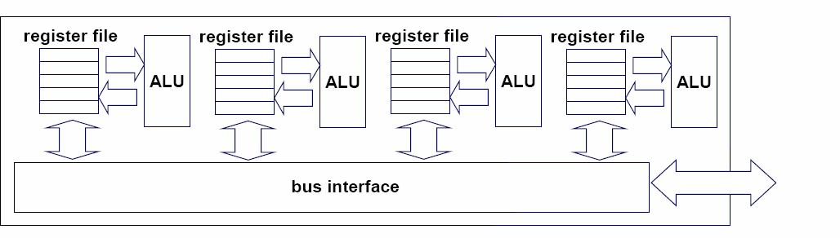
Multi-core architectures
Replicate multiple processor cores on a single die.
Core 1 Core 2 Core 3 Core 4
Multi-core CPU chip
4

Slide 46
Multi-core CPU chip
The cores fit on a single processor socket
Also called CMP (Chip Multi-Processor)
c o r e 1 | c o r e 2 | c o r e 3 | c o r e 4

Slide 47
The cores run in parallel
thread 1 thread 2 thread 3 thread 4
c
c
c
c
o
o
o
o
r e
r e
r e
r e
1
2
3
4

Slide 48
Within each core, threads are time-sliced (just like on a uniprocessor)
several threads
several threads
several threads
several threads
c
c
c
c
o
o
o
o
r e
r e
r e
r e
1
2
3
4

Slide 49
Memory in Multiprocessor System
Architectures
Shared common memory
Distributed memory. (Unshared)

Slide 50
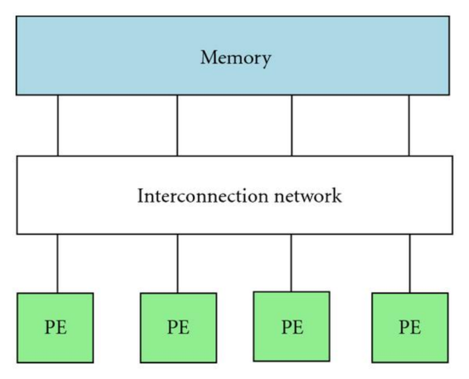
Shared memory Multiprocessors
Shared memory parallel computers vary widely, but generally have in common the ability for all processors to access all memory as global address space.
Multiple processors can operate independently but share the same memory resources.
Changes in a memory location effected by one processor are visible to all other processors.
Shared memory machines can be divided into two main classes based upon memory access times: UMA , NUMA and COMA.

Slide 51
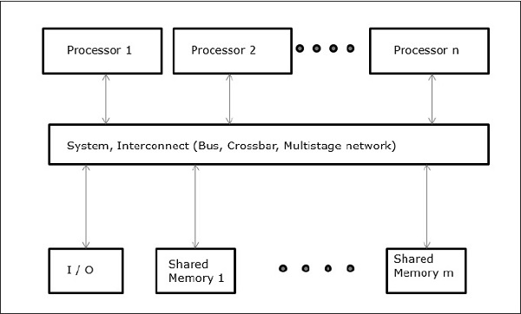
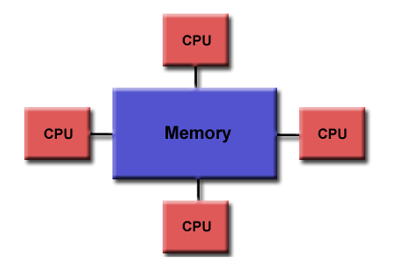
Uniform Memory Access (UMA)
Most commonly represented today by Symmetric Multiprocessor (SMP) machines.
Identical processors .
Equal access and access times to memory .
Sometimes called CC-UMA - Cache Coherent UMA. Cache coherent means if one processor updates a location in shared memory, all the other processors know about the update. Cache coherency is accomplished at the hardware level.
Image Courtesy: https://www.tutorialspoint.com/parallel_computer_architecture/parallel_computer_architecture_models.htm

Slide 52
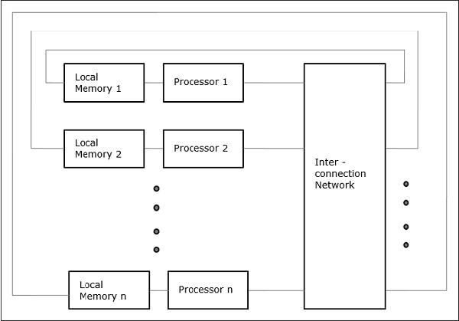
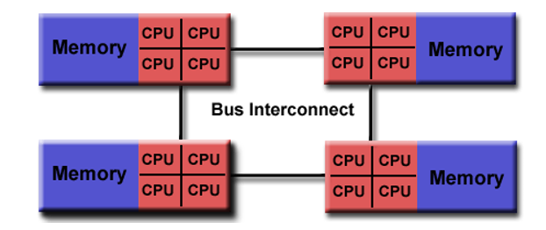
Non-Uniform Memory Access (NUMA)
Often made by physically linking two or more SMPs
One SMP can directly access memory of another SMP
Not all processors have equal access time to all memories .
Memory access across link is slower
If cache coherency is maintained, then may also be called CC-NUMA - Cache Coherent NUMA
Image Courtesy: https://www.tutorialspoint.com/parallel_computer_architecture/parallel_computer_architecture_models.htm

Slide 53
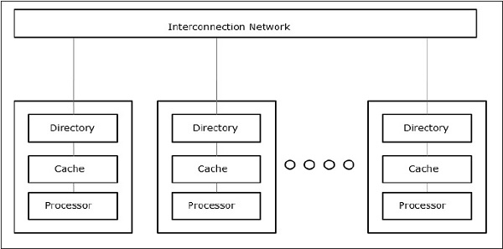
COMA model
It is a special case of NUMA machine in which the distributed main memories are converted to caches. All caches form a global address space and there is no memory hierarchy at each processor node.
Image Courtesy: https://www.tutorialspoint.com/parallel_computer_architecture/parallel_computer_architecture_models.htm

Slide 54
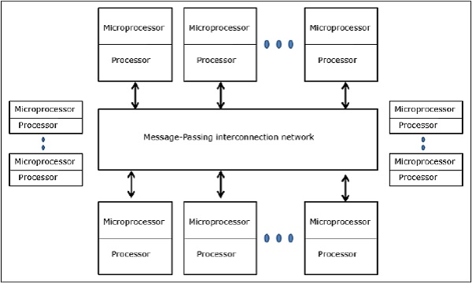
Distributed memory systems
Distributed memory systems each processor has its own memory and it require a communication network to connect inter-processor memory.
Memory addresses in one processor do not map to another processor, so there is no concept of global address space across all processors.
Because each processor has its own local memory, it operates independently.
Image Courtesy: https://www.tutorialspoint.com/parallel_computer_architecture/parallel_computer_architecture_models.htm

Slide 55
Changes it makes to its local memory have no effect on the memory of other processors. Hence, the concept of cache coherency does not apply.
When a processor needs access to data in another processor, it is usually the task of the programmer to explicitly define how and when data is communicated.
Synchronization between tasks is likewise the programmer's responsibility

Slide 56
Examples of Multi-Core Processors
Homogeneous Multi-Core Processor
Contains identical processor cores that support the same instruction set architecture (ISA)
Heterogeneous Multi-Core Processor
Consist of non-identical processor cores that support different ISA
For example: Intel CE 2110 Media that consists of an Intel Xscale processor core and an Intel Micro Signal Architecture (MSA) DSP core.
Each processor usually has own specialty

Slide 57
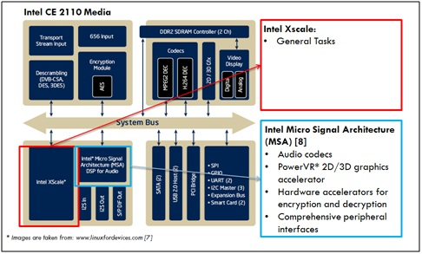

Slide 58
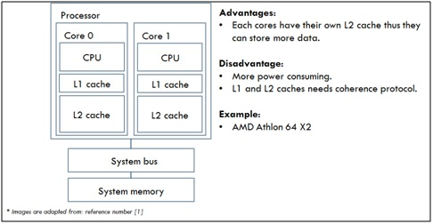
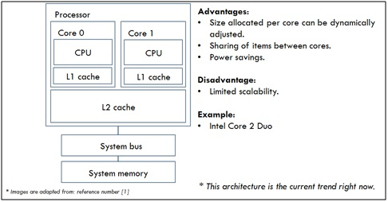
Further it contains Separate L2 cache [1]
Shared L2 cache

Slide 59
Advantages
Having a multi-core processor in a computer means that it will work faster for certain programs.
The computer may not get as hot when it is turned on.
The computer needs less power because it can turn off some sections if they aren´t needed.
More features can be added to the computer.
The signals between different CPUs travel shorter distances, therefore they degrade less.
Disadvantages
They do not work at twice the speed as a normal processor. They get only 60-80% more speed.
The speed that the computer works at depends on what the user is doing with it.
They cost more than single core processors.
They are more difficult to manage thermally than lower-density single-core processors.
Not all operating systems support more than one core.
Operating systems compiled for a multi-core processor will run slightly slower on a single-core processor.

Slide 60
“Fish” machines
hyper-threads
Dual-core
Intel Xeon processors
C O R E 1
C O R E 0
Each core is hyper-threaded
L1 cache L1 cache
L2 cache
Private L1 caches
Shared L2 caches
memory

Slide 61
Designs with private L2 caches
L1 cache | L1 cache
L2 cache | L2 cache
memory
L1 cache | L1 cache
L2 cache | L2 cache
L3 cache | L3 cache
memory
C O R E 1
C O R E 0
C O R E 1
C O R E 0
Both L1 and L2 are private
A design with L3 caches
Examples: AMD Opteron, AMD Athlon, Intel Pentium D
Example: Intel Itanium 2
32

Slide 62
Private vs shared caches
Advantages of private:
They are closer to core, so faster access
Reduces contention
Advantages of shared:
Threads on different cores can share the same cache data
More cache space available if a single (or a few) high-performance thread runs on the system

Slide 63
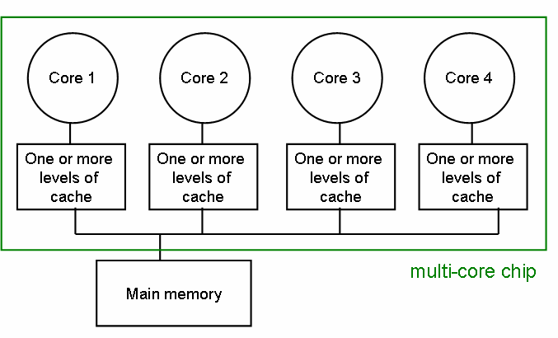
The cache coherence problem
Since we have private caches:
How to keep the data consistent across caches?
Each core should perceive the memory as a monolithic array, shared by all the cores

Slide 64
monolithic array :
A monolithic storage array has disks fixed into the array frame and connected to controllers through cache memory;
modular arrays, on the other hand, are usually based on dual controllers connected to a separate power source and connected to the disks through cables

Slide 65
The cache coherence problem
Suppose variable x initially contains 15213
Core 1
Core 2
Core 3
Core 4
One or more levels of cache
One or more levels of cache
One or more levels of cache
One or more levels of cache
multi-core chip
Main memory x=15213

Slide 66
The cache coherence problem
Core 1 reads x
Core 1
Core 2
Core 3
Core 4
One or more levels of cache x=15213
One or more levels of cache
One or more levels of cache
One or more levels of cache
multi-core chip
Main memory x=15213

Slide 67
The cache coherence problem
Core 2 reads x
Core 1
Core 2
Core 3
Core 4
One or more levels of cache x=15213
One or more levels of cache x=15213
One or more levels of cache
One or more levels of cache
multi-core chip
Main memory x=15213

Slide 68
The cache coherence problem
Core 1 writes to x, setting it to 21660
Core 1
Core 2
Core 3
Core 4
One or more levels of cache x=21660
One or more levels of cache x=15213
One or more levels of cache
One or more levels of cache
multi-core chip
Main memory x=21660
assuming write-through caches
39

Slide 69
The cache coherence problem
Core 2 attempts to read x… gets a stale copy
Core 1
Core 2
Core 3
Core 4
One or more levels of cache x=21660
One or more levels of cache x=15213
One or more levels of cache
One or more levels of cache
multi-core chip
Main memory x=21660
40

Slide 70
Solutions for cache coherence
This is a general problem with multiprocessors, not limited just to multi-core
There exist many solution algorithms, coherence protocols, etc.
A simple solution:
invalidation-based protocol with snooping
41

Slide 71
Inter-core bus
Core 1
Core 2
Core 3
Core 4
One or more levels of cache
One or more levels of cache
One or more levels of cache
One or more levels of cache
multi-core chip
Main memory
inter-core bus
42

Slide 72
Invalidation protocol with snooping
Invalidation:
If a core writes to a data item, all other copies of this data item in other caches are invalidated
Snooping:
All cores continuously “snoop” (monitor) the bus connecting the cores.
43

Slide 73
The cache coherence problem
Revisited: Cores 1 and 2 have both read x
Core 1
Core 2
Core 3
Core 4
One or more levels of cache x=15213
One or more levels of cache x=15213
One or more levels of cache
One or more levels of cache
multi-core chip
Main memory x=15213
44

Slide 74
The cache coherence problem
Core 1 writes to x, setting it to 21660
Core 1
Core 2
Core 3
Core 4
One or more levels of cache x=21660
One or more levels of cache x=15213
One or more levels of cache
One or more levels of cache
sends
INVALIDATED
invalidation
multi-core chip
request
Main memory x=21660
assuming write-through caches
inter-core bus
45

Slide 75
The cache coherence problem
After invalidation:
Core 1
Core 2
Core 3
Core 4
One or more levels of cache x=21660
One or more levels of cache
One or more levels of cache
One or more levels of cache
multi-core chip
Main memory x=21660

Slide 76
The cache coherence problem
Core 2 reads x. Cache misses, and loads the new copy.
Core 1
Core 2
Core 3
Core 4
One or more levels of cache x=21660
One or more levels of cache x=21660
One or more levels of cache
One or more levels of cache
multi-core chip
Main memory x=21660

Slide 77
Alternative to invalidate protocol: update protocol
Core 1 writes x=21660:
Core 1
Core 2
Core 3
Core 4
One or more levels of cache x=21660
One or more levels of cache x=21660
One or more levels of cache
One or more levels of cache
UPDATED
broadcasts
multi-core chip
updated value
Main memory x=21660
assuming write-through caches
inter-core bus
48

Slide 78
Invalidation vs update
Multiple writes to the same location
invalidation: only the first time
update: must broadcast each write
(which includes new variable value)
Invalidation generally performs better: it generates less bus traffic

Slide 79
Invalidation protocols
This was just the basic invalidation protocol
More sophisticated protocols use extra cache state bits
MSI, MESI
(Modified, Exclusive, Shared, Invalid)

Slide 80
MESI Protocol
For Multiprocessor Systems

Slide 81
The MESI protocol is one implementation of enforcing data integrity among caches sharing data; the write once write policy is a method to keep the protocol performing efficiently by avoiding superfluous data traffic on the system bus

Slide 82
MESI Protocol (1)
A practical multiprocessor invalidate protocol which attempts to minimize bus usage.
Allows usage of a ‘write back’ scheme - i.e. main memory not updated until ‘dirty’ cache line is displaced
Extension of usual cache tags, i.e. invalid tag and ‘dirty’ tag in normal write back cache.

Slide 83
MESI Protocol (2)
Any cache line can be in one of 4 states (2 bits)
Modified - cache line has been modified, is different from main memory - is the only cached copy. (multiprocessor ‘dirty’)
Exclusive - cache line is the same as main memory and is the only cached copy
Shared - Same as main memory but copies may exist in other caches.
Invalid - Line data is not valid (as in simple cache)

Slide 84
MESI Protocol (3)
Cache line changes state as a function of memory access events.
Event may be either
Due to local processor activity (i.e. cache access)
Due to bus activity - as a result of snooping
Cache line has its own state affected only if address matches

Slide 85
MESI Protocol (4)
Operation can be described informally by looking at action in local processor
Read Hit
Read Miss
Write Hit
Write Miss
More formally by state transition diagram

Slide 86
MESI Local Read Hit
Line must be in one of MES
This must be correct local value (if M it must have been modified locally)
Simply return value
No state change

Slide 87
MESI Local Read Miss (1)
No other copy in caches
Processor makes bus request to memory
Value read to local cache, marked E
One cache has E copy
Processor makes bus request to memory
Snooping cache puts copy value on the bus
Memory access is abandoned
Local processor caches value
Both lines set to S

Slide 88
MESI Local Read Miss (2)
Several caches have S copy
Processor makes bus request to memory
One cache puts copy value on the bus (arbitrated)
Memory access is abandoned
Local processor caches value
Local copy set to S
Other copies remain S

Slide 89
MESI Local Read Miss (3)
One cache has M copy
Processor makes bus request to memory
Snooping cache puts copy value on the bus
Memory access is abandoned
Local processor caches value
Local copy tagged S
Source (M) value copied back to memory
Source value M -> S

Slide 90
MESI Local Write Hit (1)
Line must be one of MES
M
line is exclusive and already ‘dirty’
Update local cache value
no state change
E
Update local cache value
State E -> M

Slide 91
MESI Local Write Hit (2)
S
Processor broadcasts an invalidate on bus
Snooping processors with S copy change S->I
Local cache value is updated
Local state change S->M

Slide 92
MESI Local Write Miss (1)
Detailed action depends on copies in other processors
No other copies
Value read from memory to local cache (?)
Value updated
Local copy state set to M

Slide 93
MESI Local Write Miss (2)
Other copies, either one in state E or more in state S
Value read from memory to local cache - bus transaction marked RWITM (read with intent to modify)
Snooping processors see this and set their copy state to I
Local copy updated & state set to M

Slide 94
MESI Local Write Miss (3)
Another copy in state M
Processor issues bus transaction marked RWITM
Snooping processor sees this
Blocks RWITM request
Takes control of bus
Writes back its copy to memory
Sets its copy state to I

Slide 95
MESI Local Write Miss (4)
Another copy in state M (continued)
Original local processor re-issues RWITM request
Is now simple no-copy case
Value read from memory to local cache
Local copy value updated
Local copy state set to M

Slide 96
Putting it all together
All of this information can be described compactly using a state transition diagram
Diagram shows what happens to a cache line in a processor as a result of
memory accesses made by that processor (read hit/miss, write hit/miss)
memory accesses made by other processors that result in bus transactions observed by this snoopy cache (Mem read, RWITM,Invalidate)

Slide 97
MESI – locally initiated accesses
Read
Miss(sh)
Invalid
Shared
Read
Hit
Mem Read
Read
Miss(ex)
Invalidate
RWITM
Mem Read
Write
Hit
Write
Miss
Modified
Exclusive
Read
Hit
Read
Hit
Write
Hit
Write
Hit
= bus transaction

Slide 98
MESI – remotely initiated accesses
Mem Read
Invalid
Invalidate
Shared
Mem Read
RWITM
Mem Read
RWITM
Modified
Exclusive
= copy back

Slide 99
MESI notes
There are minor variations (particularly to do with write miss)
Normal ‘write back’ when cache line is evicted is done if line state is M
Multi-level caches
If caches are inclusive, only the lowest level cache needs to snoop on the bus

Slide 100
THANK YOU

